Slide 1
Admin Dashboard Analysis
Team Details:
D.Reshwanth (20EG105516)
S.Santosh (20EG105560)
M.Uday Kiran (20EG105733)
S.Bhagya Rekha
Assistant Professor, CSE

Slide 2
Introduction
Admin dashboards offer a quick snapshot of key metrics and performance indicators. Utilizing data visualizations and real-time updates, decision-makers gain actionable insights. Customization and data integration provide a comprehensive view, while interactivity enhances decision support. Crucially, robust security measures safeguard sensitive information on these dashboards.
Purpose:
Central hub for monitoring and managing organizational operations.
Data Visualization:
Visual representation of key metrics using charts and graphs.
KPIs:
Focus on Key Performance Indicators for quick assessment.
Real-time Monitoring:
Provides real-time updates for proactive decision-making.
Customization:
Customizable dashboards to meet user-specific needs.
Interactivity:
Interactive features for detailed data exploration.
Data Integration:
Aggregates data from various sources for a comprehensive view.
Decision Support:
Offers actionable insights for informed decision-making.
Security:
Robust security measures to protect sensitive information.

Slide 3
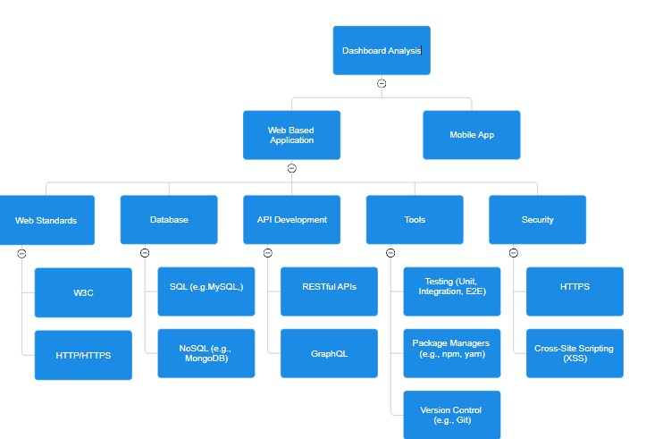
Concept Tree

Slide 4
Literature
S.no | Author | Strategies | Advantages | Disadvantages
1. | Praveen Gauravaram | Security analysis of salt/password Hashes, 2019 | If security is not much an issue we can choose fast hashing algorithms | Fast hashing algorithms can be easily cracked
2. | Duong Thi Anh Hoang | A Hypergraph-based approach to On-demand Data warehousing systems, 2020 | Multidimensional hypergraph helps in dynamic analysis | slow down the loading time of a webpage
3. | Aditya A. Shastri | Study of Efficient and Effective security model for database specially designed to avoid internal threats, 2019 | No user is able to obtain information without authorization | No concept of encryption is used anywhere in the mode
4. | Jerry Louis | Detection of session hijacking, 2020 | Analyzing changes in the database which user doesn’t remember doing, one can detect the attack. | harder for the developers to create a secure authentication process.

Slide 5
Problem Statement
The current organizational setup faces challenges due to the absence of an efficient Admin Dashboard, leading to issues like data overload, inefficient user management, limited analytics, and poor system monitoring. These challenges impact compliance, security, customization, and integration. Addressing these issues is crucial for enhancing operational efficiency, enabling better decision-making, and ensuring a secure organizational environment. Implementing a comprehensive Admin Dashboard is essential for streamlined management and monitoring, providing actionable insights to administrators.
Disadvantages:
Overreliance on Metrics: Narrow focus, neglecting contextual factors; decisions may lack nuance.
Data Overload: Excessive metrics overwhelm users, causing confusion and decision paralysis.
Security Concerns: Displaying sensitive data poses risks, potentially leading to breaches and consequences.

Slide 6
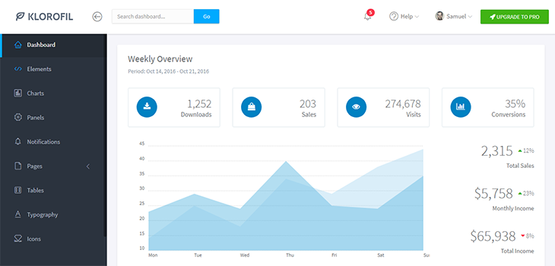
Problem Illustration
The user interface (UI) of the Admin Dashboard is not user-friendly and lacks intuitive navigation, causing frustration and difficulty for naïve users trying to navigate through the platform.

Slide 7
Proposed Method
The proposed Admin Dashboard Analysis method is a systematic and data-driven approach to optimize system performance. It initiates with comprehensive data collection from diverse sources like website analytics, user interactions, and sales records. Key Performance Indicators (KPIs) are meticulously identified, aligning with specific business goals to measure success. A user-friendly dashboard is designed to visualize and consolidate real-time data, promoting quick and informed decision-making.
The method incorporates user segmentation, allowing for a detailed analysis of different user groups and their interactions. Predictive analytics models are integrated, enabling administrators to forecast trends and potential issues. Customizable reporting ensures flexibility, empowering administrators to focus on specific metrics critical to their objectives.
This dynamic method not only empowers administrators with actionable insights but also creates a feedback loop for sustained refinement, ensuring the Admin Dashboard remains a powerful and adaptable tool for monitoring, analyzing, and enhancing system performance.

Slide 8
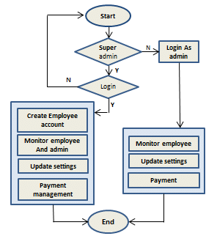
Proposed Method Illustration

Slide 9
Parameters
Conversion Rate:
Formula: (Number of Conversions / Number of Visits) * 100
Description: Measures the percentage of visitors who complete a desired action (e.g., making a purchase).
Bounce Rate:
Formula: (Number of Single Page Visits / Total Visits) * 100
Description: Indicates the percentage of visitors who navigate away from the site after viewing only one page.
User Engagement:
Metrics: Average Session Duration, Pages Per Session, etc.
Description: Evaluates how actively users are interacting with the platform.
Customer Acquisition Cost (CAC):
Formula: Total Marketing Costs / Number of New Customers Acquired
Description: Measures the cost of acquiring a new customer through marketing efforts.

Slide 10
Experiment Environment
Programming Language: Html, CSS, Javascript (MERN)
Working Environment: VSCODE
Node Version: 21.6.1
MongoDB Version: MongoDB 7.0
ReactJS Version: 18.1.0
Express Version 4.18.2
Packages: npm, yarn
Libraries React, JQuery

Slide 11
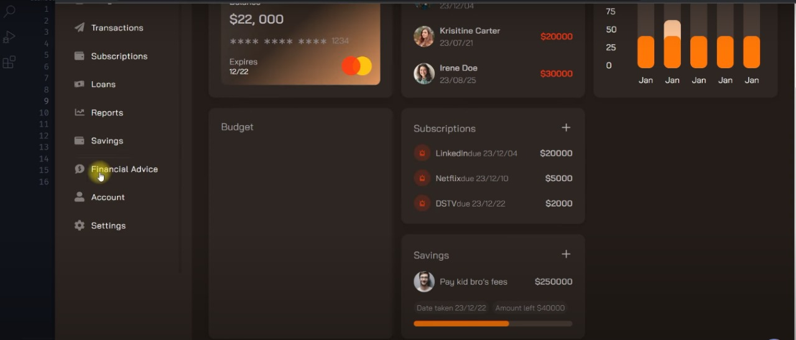
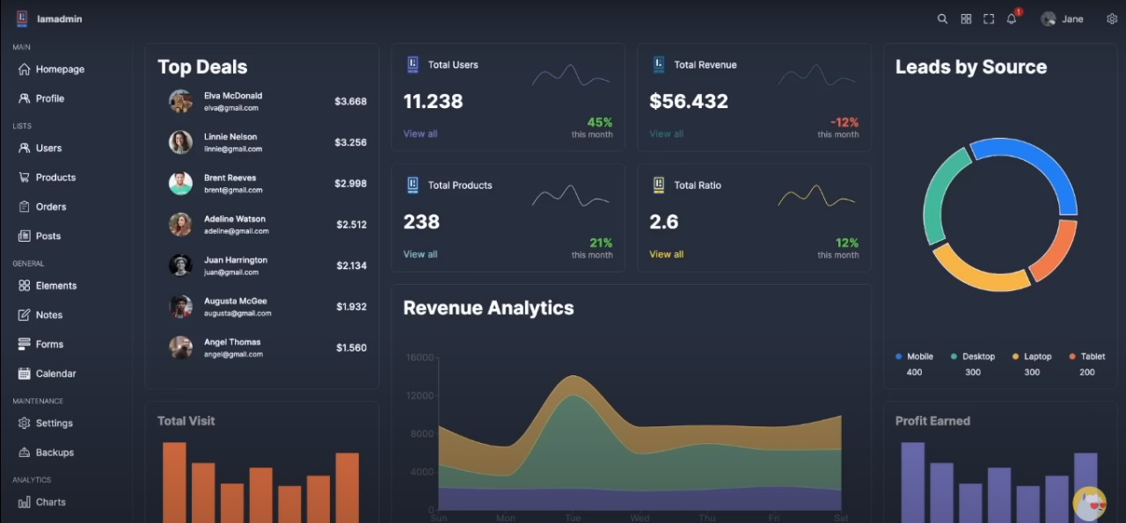
Experiment Screenshots

Slide 12
Project status
S.No | Functionality | Status
1 | Abstract | Completed
2 | Requirements | Completed
3 | Paper Writing and Journal Submission | Not yet started
4 | Implementation | In Progress

Slide 13
References
[1] Duong Thi Anh Hoang, Thanh Binh Nguyen and A MinTjoa. “Dashboard by-Example: A Hypergraph-basedapproach to On-demand Data warehousing systems”.International Conference on Systems, Man, and Cybernetics
COEX, Seoul, Korea on. IEEE, October 14-17, 2020,
[2] Gauravaram, Praveen. "Security Analysis of salt/password Hashes”. Advanced Computer Science Applications and Technologies (ACSAT), 2019
International Conference on. IEEE, 2019.
[3] Shastri, Aditya A., and P. N. Chatur. "Efficient andeffective security model for database specially designed toavoid internal threats”.Smart Technologies and Management for Computing, Communication, Controls, Energy and Materials (ICSTM), 2019 International Conference on. IEEE, 2019.
[4] Louis, Jerry. "Detection of session hijacking”. University of Bedfordshire Repository 2020.
[5] Dashboard insite ”what is dashboard”, [online]: http://www.dashboardinsight.com/articles/digitaldashboards/fundamentals/what-is-a-dashboard.aspx
[6] OWASP “Top 10 2013-Top 10 vulnerabilities”,[online]:
http://www.owasp.org/index.php/Top_10_2019-Top_10

Slide 14
Thank you

Slide 15
Project seminar–I Evaluation
S.No | Rubrics | Marks
1 | Concept Introduction | 4
2 | Literature and Parameter | 5
3 | Problem and Problem Illustration | 8
4 | Proposed Method and Illustration | 8
Total |  | 25

